Slide 1
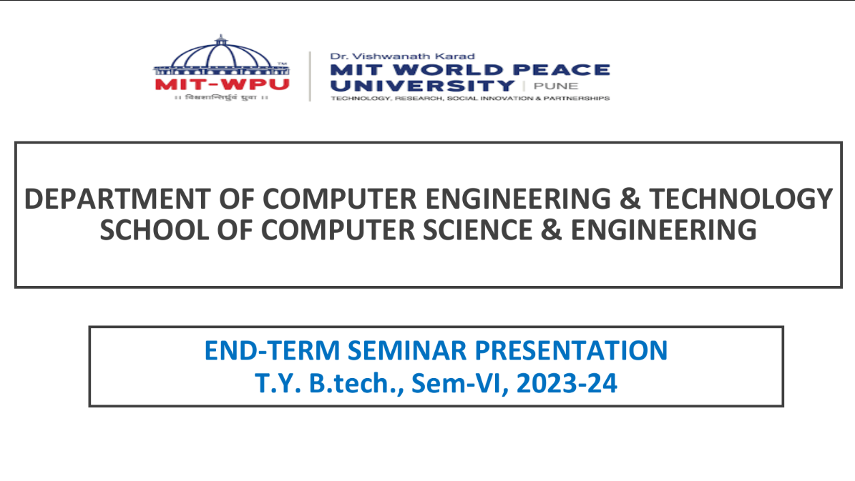

Slide 2

Role of AI in Education
Aaron Philip (1032210163)
Dr. Vaishali Suryawanshi

Slide 3
TABLE OF CONTENTS
1
Introduction
2
Literature Survey
3
Result
4
Conclusion
5
References
6
Publication

Slide 4
1
Introduction
In the field of education, Artificial Intelligence (AI) stands as a transformative force, reshaping traditional learning methods. AI has emerged as a powerful ally, offering unprecedented opportunities to enhance educational experiences. From personalized learning journeys to adaptive assessments, AI is redefining how we gain and apply knowledge. This seminar delves into the multifaceted role of AI in education, exploring its potential to revolutionize teaching methodologies, cater to diverse learning needs, and pave the way for a more inclusive and effective learning environment.

Slide 5
What changes is AI making in education ?
Personalized Learning Experience
Efficient Content Review
Adaptive Assessment and Feedback
Content Curation and Recommendation
Accessibility and Inclusivity

Slide 6
2
Literature Survey
How to Build an AI Tutor that Can Adapt to Any Course and Provide Accurate Answers Using Large Language Model and Retrieval Augmented Generation.
Understanding Effective Teacher Practices in AI Supported Classrooms using Transmodal Ordered Network Analysis.
Language-Agnostic Transformers and Assessing ChatGPT-Based Query Rewriting for Multilingual Document-Grounded QA
Artificial intelligence in intelligent tutoring systems toward sustainable education: a systematic review
YouTube Video Summarizer using NLP Review

Slide 7
3
Research Papers
Paper | Title | Summary | Gaps
Dong, C. (2021). How to Build an AI Tutor that Can Adapt to Any Course and Provide Accurate Answers Using Large Language Model and Retrieval-Augmented Generation. Retrieved from https://doi.org/10.48550/arXiv.2311.17696 | How to Build an AI Tutor that Can Adapt to Any Course and Provide Accurate Answers Using Large Language Model and Retrieval-Augmented Generation | This paper introduces an AI Tutor web application that provides personalized tutoring in any subject using state-of-the-art Large Language Model (LLM). It uses advanced techniques for accurate, natural question answering by ingesting course materials to construct an adaptive knowledge base tailored to the course. | Computational Expense Statistical and Probabilistic Nature Bias and Errors

Slide 8
Research Papers
3
Paper | Title | Summary | Gaps
Borchers, C., Wang, Y., Karumbaiah, S., Ashiq, M., Shaffer, D. W., & Aleven, V. (2021). Revealing Networks: Understanding Effective Teacher Practices in AI-Supported Classrooms using Transmodal Ordered Network Analysis. Retrieved from https://doi.org/10.48550/arXiv.2312.10826 (2021) | Revealing Networks: Understanding Effective Teacher Practices in AI-Supported Classrooms using Transmodal Ordered Network Analysis | This study uses transmodal ordered network analysis to understand effective teacher practices in mathematics classrooms working with AI tutors. It incorporates teacher practices captured by position tracking and human observation codes into modeling, significantly improving the inference of student improvement in the AI tutor.​ | Not enough Data to further the implementation process Limited only to the subject of Mathemcatics

Slide 9
3
Research Papers
Paper | Title | Summary | Gaps
Mangotra, H., Dabas, V., Khetarpal, B., Verma, A., Singhal, S., & Mohapatra, A. K. University Auto Reply FAQ Chatbot Using NLP and Neural Networks. Artificial Intelligence and Applications, Vol. XX(XX), 1–5 (2021) | University Auto Reply FAQ Chatbot Using NLP and Neural Networks | The paper presents a chatbot system for universities that uses NLP and neural networks to automate responses to FAQs, improving communication and user experience. It addresses the challenges of handling numerous inquiries from students, faculty, and staff by proposing a chatbot system that understands and responds to natural language queries. | Limited Data Availability Use of Simple Model Structures Fine-Tuning Pre-Trained Models

Slide 10
3
Research Papers
Paper | Title | Summary | Gaps
S., Tiwari, S. D., Potnis, M., Bansal, S., Mitamura, T., & Nyberg, E. (2023). Language Agnostic Transformers and Assessing ChatGPT-Based Query Rewriting for Multilingual Document Grounded QA. Language Technologies Institute, Carnegie Mellon University (2023) | Language-Agnostic Transformers and Assessing ChatGPT-Based Query Rewriting for Multilingual Document-Grounded QA | The paper examines the use of Language-Agnostic Transformers in multilingual Document-Grounded Question Answering (QA) tasks, with a focus on ChatGPT-based query rewriting. It showcases the effectiveness of ChatGPT in improving multilingual QA by reformulating queries across languages, enhancing cross-lingual information retrieval and comprehension. | Sample Size Limitation Context Size Constraint Inability to Test Closed Architecture of ChatGPT

Slide 11
3
Research Papers
Paper | Title | Summary | Gaps
Singh, Y., Kumar, R., Kabdal, S., & Upadhyay, P. (2023). YouTube Video Summarizer using NLP: A Review. International Journal of Performance Evaluation, vol. 19, no. 12, December 2023 | YouTube Video Summarizer using NLP Review | This review paper delves into the emerging realm of YouTube video summarization utilizing Natural Language Processing (NLP) techniques, a critical area of research with increasing prominence in our multimedia-rich digital age. The paper commences with a broad overview of the field, elaborating on the need for automated video summarization tools to navigate and condense the massive, ever-growing sea of YouTube content and metadata. | Ambiguity and Complexity in Video Content Limited Ability to Handle Visual Content

Slide 12
Technologies Used in the papers
Large Language Models : Large language models are sophisticated artificial intelligence systems trained on vast amounts of text data. They possess the ability to generate human-like text and understand natural language with remarkable accuracy. These models have revolutionized various fields including natural language processing, enabling tasks such as language translation, text generation, and sentiment analysis at unprecedented levels of complexity and quality.
Retrieval-Augmented Generation : RAG, or Retrieval-Augmented Generation, is an advanced natural language processing technique that integrates retrieval-based and generative models. It combines the strengths of both approaches by first retrieving relevant information from a large knowledge base and then generating text based on that information. RAG has shown significant promise in tasks such as question answering and text summarization by enhancing the generation process with contextually relevant information retrieved from external sources.

Slide 13
Technologies Used in the papers
3. Transmodal order analysis : Transmodal order analysis refers to a technique for analyzing complex systems by integrating data from different sources or modalities. It involves studying patterns and relationships across diverse types of data, such as text, images, and numerical values, to extract meaningful insights
4. mDPR models : Multimodal Dense Passage Retrieval models, are advanced neural network architectures designed for efficient information retrieval tasks across different modalities. These models excel at retrieving relevant passages of text from large corpora in response to user queries, integrating both textual and non-textual modalities such as images or knowledge graphs.

Slide 14
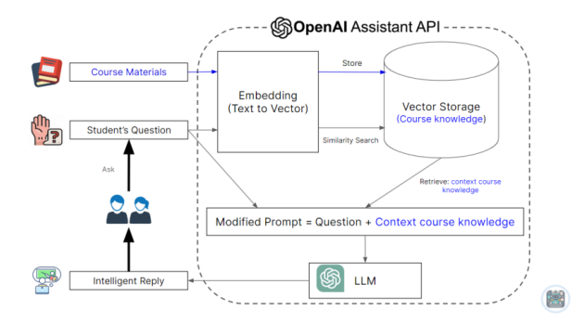
Methodologies Used in the papers
The system comprises four key components: Course Materials, Student's Question, AI Tutor, and OpenAI Assistants API. Course materials are domain-specific documents uploaded by the user, stored in a vector database for retrieval and generation. The AI Tutor utilizes the OpenAI Assistants API for text embedding, vector storage, similarity-based retrieval, and Retrieval-Augmented Generation (RAG) using a large language model (LLM), such as gpt-4-1106-preview, augmented with a retrieval mechanism. The API also manages chat history for coherent replies and offers user control over deleting chat history.

Slide 15
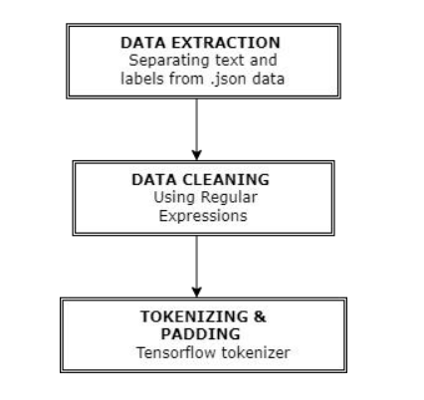
Methodologies Used in the papers
This methodology involves four steps: Data Extraction, Data Cleaning, Tokenizing, and Padding. First, relevant data is extracted from the source. Then, the data is cleaned to remove noise and inconsistencies. Next, it's tokenized into smaller units for processing. Finally, padding ensures uniformity in sequence length for model input. This sequence ensures data readiness for subsequent machine learning or natural language processing tasks.

Slide 16
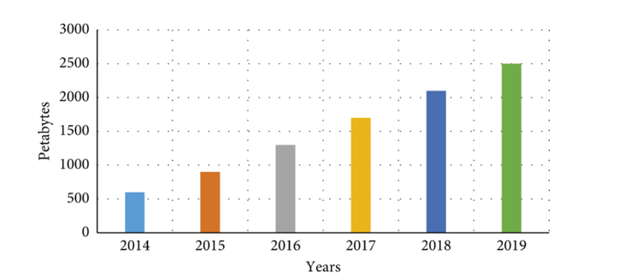
Need for an AI based education
With YouTube's video data growing in petabytes yearly, an AI tutor becomes invaluable. It efficiently goes through this vast content, delivering personalized learning experiences by extracting and summarizing relevant information using advanced algorithms. This enhances education accessibility and effectiveness in the digital age.

Slide 17
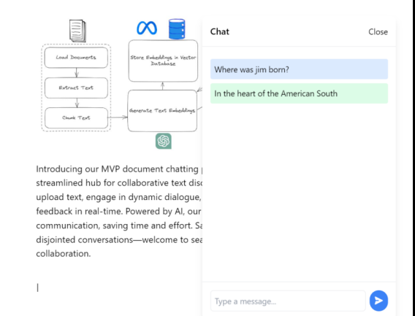
Experimental Work
This application revolutionizes document management and querying by integrating cutting-edge open-source technologies. With MongoDB as the foundation, users enjoy a flexible platform for uploading only text documents. Uses Pinecone's cloud-based vector database enables efficient similarity search, for keyword-based queries. Additionally, the integration of an open-source Large Language Model enhances the querying experience by capturing nuanced relationships within documents.

Slide 18
Experimental Work (Technology and Details)
ReactJS and NodeJS : The application is built using ReactJS as the frontend and NodeJS as the backend
MongoDB: Flexible NoSQL database for storing user-uploaded documents in JSON-like format.
Pinecone: Cloud-based vector database optimized for high-dimensional vector embedding, facilitating efficient similarity search.
LLM (Large Language Model): Uses Open source Models such as Google’s PaLm2 and BERT
Open Source Deployment: Utilized Vercel for deployment of both server as well as client side applications
Document Upload: Users upload documents via app interface, stored in MongoDB and Pinecone.
Text Embedding Generation: Documents processed to create dense vector representations.
LLM Query Interface: Users query documents through LLM-based interface, leveraging Pinecone for efficient search.

Slide 19
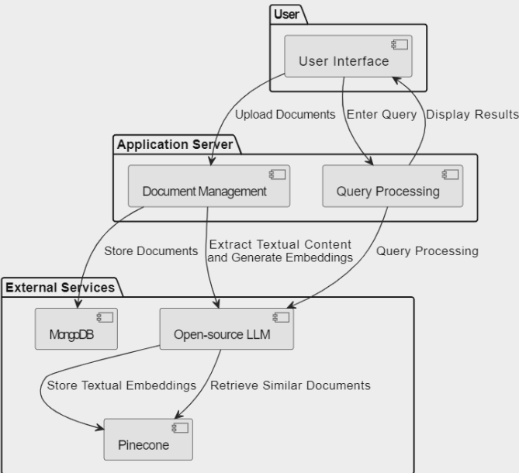
Experimental Work System Architecture

Slide 20
Experimental Work (Demo)

Slide 21
Experimental Work Models Used
Google PaLm 2 Embedding Model PaLM 2, Google's latest large language model, builds upon their legacy of pioneering research in machine learning and responsible AI. This next-generation model excels in a variety of advanced reasoning tasks, including code and math processing, classification, question answering, translation, and multilingual proficiency, surpassing previous state-of-the-art LLMs like PaLM.
BERT large model is a transformers model pretrained on a large corpus of English data in a self-supervised fashion. This means it was pretrained on the raw texts only, with no humans labelling them in any way (which is why it can use lots of publicly available data) with an automatic process to generate inputs and labels from those texts

Slide 22
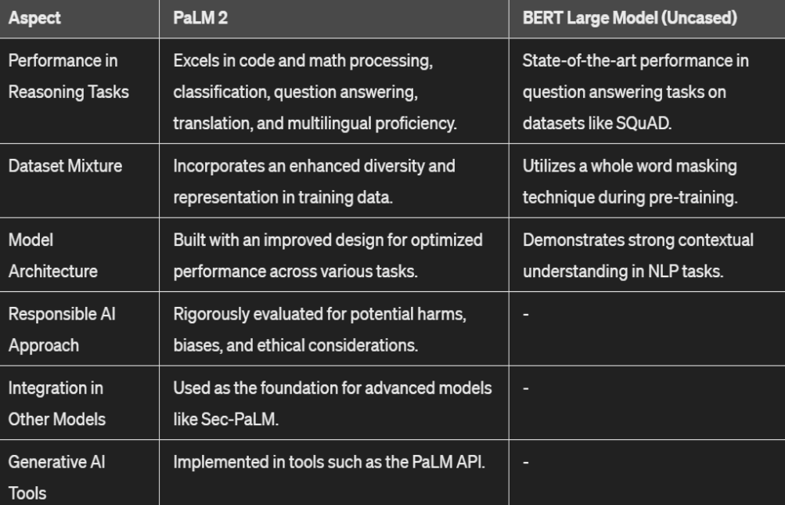
Model Differences

Slide 23
3
Result
The integration of Artificial Intelligence (AI) in education marks a transformative shift, revolutionizing learning approaches. AI enables personalized learning experiences by adapting to individual students' needs and preferences. Through AI-driven tutoring systems, students receive tailored instruction, fostering engagement and comprehension. Ultimately, AI empowers educators to deliver inclusive learning experiences, equipping students with essential skills for success in a complex, digital world.

Slide 24
4
Conclusion
In conclusion, the incorporation of Artificial Intelligence (AI) in education represents a transformative leap forward in enhancing learning outcomes and experiences. By leveraging AI technologies such as natural language processing and machine learning, education systems can provide personalized, adaptive, and data-driven approaches to teaching and learning. Through AI-driven tutoring, automated grading, and personalized content delivery, educators can cater to individual student needs more effectively, fostering deeper engagement and understanding. As AI continues to evolve, its role in education promises to revolutionize teaching methodologies, improve accessibility, and equip students with the skills needed for success in the 21st century.

Slide 25
5
References
Dong, C. (2021). How to Build an AI Tutor that Can Adapt to Any Course and Provide Accurate Answers Using Large Language Model and Retrieval-Augmented Generation. Retrieved from https://doi.org/10.48550/arXiv.2311.17696
Borchers, C., Wang, Y., Karumbaiah, S., Ashiq, M., Shaffer, D. W., & Aleven, V. (2021). Revealing Networks: Understanding Effective Teacher Practices in AI-Supported Classrooms using Transmodal Ordered Network Analysis. Retrieved from https://doi.org/10.48550/arXiv.2312.10826
Mangotra, H., Dabas, V., Khetarpal, B., Verma, A., Singhal, S., & Mohapatra, A. K. University Auto Reply FAQ Chatbot Using NLP and Neural Networks. Artificial Intelligence and Applications, Vol. XX(XX), 1–5

Slide 26
5
References
S., Tiwari, S. D., Potnis, M., Bansal, S., Mitamura, T., & Nyberg, E. (2023). Language Agnostic Transformers and Assessing ChatGPT-Based Query Rewriting for Multilingual Document Grounded QA. Language Technologies Institute, Carnegie Mellon University
Singh, Y., Kumar, R., Kabdal, S., & Upadhyay, P. (2023). YouTube Video Summarizer using NLP: A Review. International Journal of Performance Evaluation, vol. 19, no. 12, December 2023

Slide 27
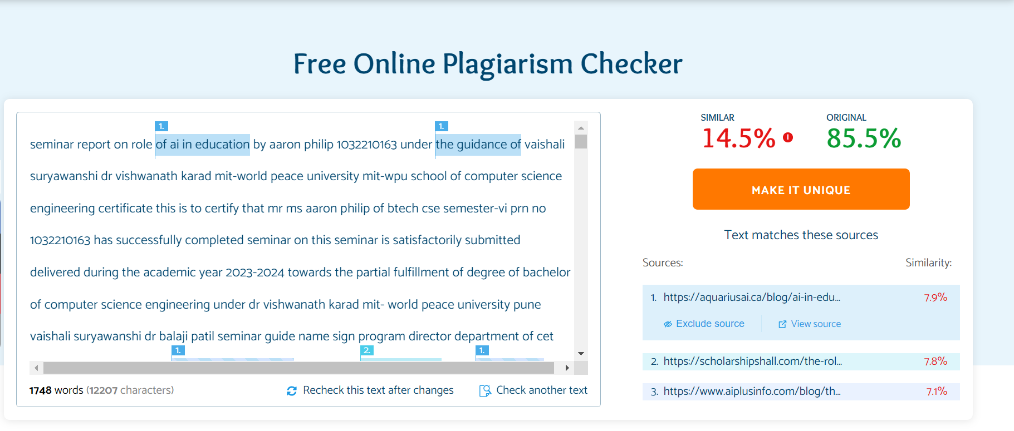
5
Plagiarism Check

Slide 28

6
Publications
Published Article available on Medium.com
https://medium.com/@aaronphilip2003/role-of-ai-in-education-5755fd997570

Slide 29
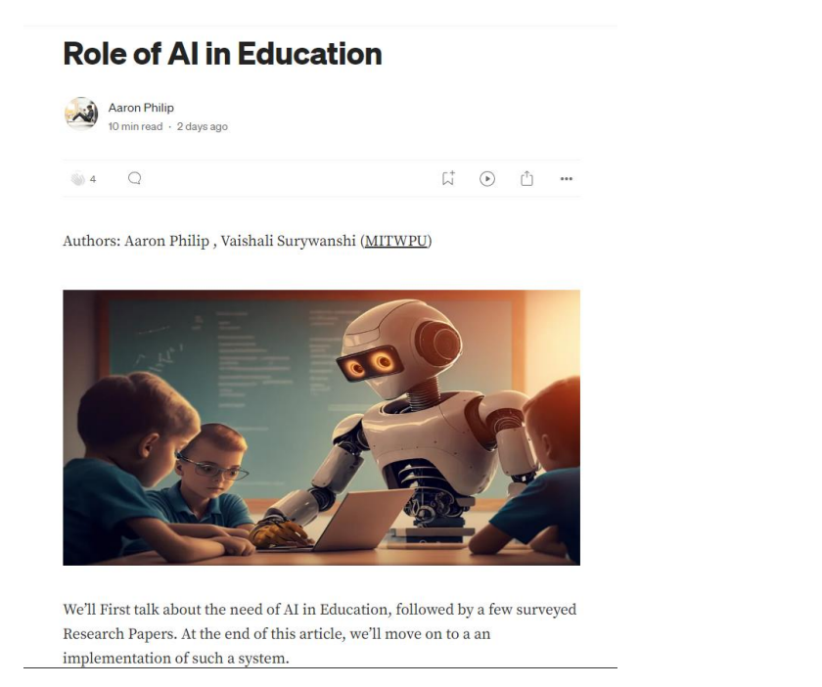

Slide 30
THANK YOU!

